Slide 1


CHAPTER 9
Forecasting Analytics
Of course, there is no accurate forecast, but at times this shifts the focus for ... If there is no perfect plan, is there such thing as a good enough plan? ...

Slide 2
Introduction
Forecasting analytics (FA) is a subset of predictive analytics focusing only on predictions about the future. This does not necessarily include predicting exercises typically in the likes of regression analysis aiming at the “holy grail” of causality! In forecasting analytics, we do not underestimate the importance of causality, but we can live without it, and as long as we can accurately predict elements of the future, we are good to go. In a nutshell, forecasting analytics is the extensive use of data and quantitative models as well as evidence-based management and judgment so as to produce alternative point and density estimates, paths, predictions, and scenarios for the
future.

Slide 3
Forecasting analytics is probably the most difficult part of the analytics trio: descriptive, prescriptive, and predictive analytics. More challenging as it is about the future, and although everybody is right once the forecasts are set, only the very few (and brave!) will be right when the future is realized and the forecast accuracy is evaluated. That is the judgment day for any predictive analytics professional
(PAP).

Slide 4
Forecasting analytics is also the next big thing in the employment front, with
millions of jobs on demand expected in the next few years.2
Forecasting analytics is a crucial function in any twenty-first century company
and is the one that can truly give a competitive advantage to nowadays managers
and entrepreneurs as a bad forecast can be translated into:
Either
... lost sales, thus poor service and unsatisfied customers!
Or
... products left in shelves, thus high inventory and logistics costs!

Slide 5
In practice,
although forecasting is a key function in operations, it is usually very poorly performed. This chapter aims to shed light on the practical aspects of everyday business forecasting analytics, by adopting some well-informed, academically proven, and easily implemented processes, which in most cases are just simple heuristics. Given that this is just a chapter and not an entire book—as it may well could be—focus is given on the process (that we abbreviate as AFA—applied forecasting analytics process) and some basic techniques but not all the specific techniques and algorithms used at each stage.
If you had googled ... “forecasting” (back in 2005) here is what you would have
got:
Forecasting is the process of estimation in unknown situations. Prediction is a similar,
but more general term, and usually refers to estimation of time series, cross-sectional or
longitudinal data. In more recent years, Forecasting has evolved into the practice of Demand
Planning in everyday business forecasting for manufacturing companies. The discipline of
demand planning, also sometimes referred to as supply chain forecasting, embraces both
statistical forecasting and consensus process.

Slide 6
The first sentence of the quote is the most important one: forecasting is more-or_x0002_less about estimating in unknown situations—thus your only weapon is the past and how much the latter resembles the former. This wiki-quote continues with nicely distinguishing between forecasting and prediction. In this chapter, we will use them interchangeably.7 The next sentence fully aligns with the beliefs of the authors of this chapter: Forecasting has evolved into the practice of Demand Planning in everyday business forecasting for manufacturing companies ... sometimes referred to as supply chain forecasting.
The world of everyday business forecasting, comes with the assumption that
some kind of regularly observed quantitative information will be available for the
products under consideration. In other words, time-series data will be available.
A time series (Fig. 12.1) is just a series of observations over a long period of
time; those observations are usually taken in equally distanced periods (months,
week, quarters, etc.). That is typically how data look like in business and operational
forecasting; in most cases, observations for more than 3 years per product are
available, while these are recorded quite frequently (every month or less).
But this is not always the case as:

Slide 7
You may have cross-sectional data, data referring to the same point of time but for different product/services, etc.—for example, sales for ten different car makes in a given day.
You may have no data at all—so you end up using entirely your judgment as tomake some forecasts.
In this chapter, focus is basically given to time-series forecasting and how this integrates efficiently with judgmental adjustments. These adjustments are driven rom all sources of marketing intelligence.9 Analysis and forecasting of cross sectional data that is mainly the focus of regression analysis, but still remain out of the core scope of this chapter (please see Chap. 7 of this volume).

Slide 8
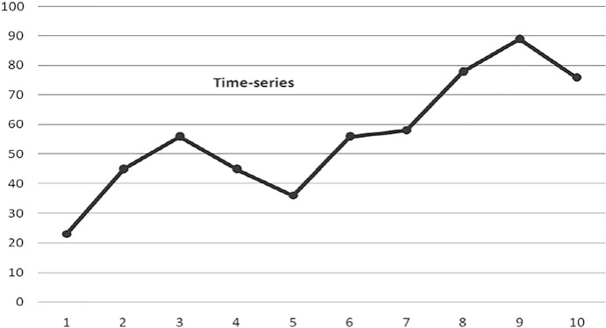
Fig. 12.1 A time series

Slide 9
In Fig. 12.2, the aforementioned process would be to ... :
... get the thick-line right in the first place ...!
This thick-line stands for the history of the specific product you are interested
to forecast. As explained in the data collection chapter (Chap. 2), data-related
problems such as outliers, missing data, and sudden shifts need to be treated
before forecasting. Also, data transformations, such as taking roots, logarithms, and
differencing, might be required to conform to the requirements of the model.
The next logical step would be to project this thick-line into the future: forecast_x0002_ing the available time series. Time-series forecasting is based on the assumption
that a particular variable will behave in the future in much the same way as it
behaves in the past. Thus, the dotted-line should be the “natural” extension of
the thick-black-line. Natural ... in the sense that history repeats itself. This is the
basic assumption of statistical forecasting; thus Statistics—abbreviated Stats—is the
second fundamental part of the forecasting process.
We will call this a point-forecast. In most of the cases you will usually be
interested in many points of time in the future, so forecasts for the full forecasting
horizon as it is usually termed, and not just a single-point forecast, are of interest.

Slide 10
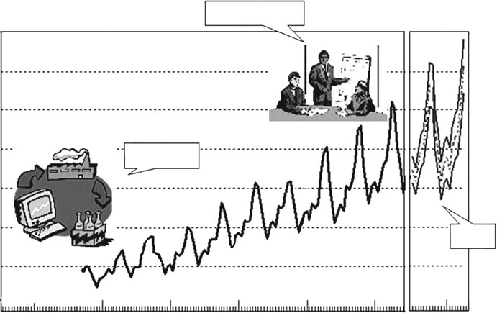
2000 2002 2004 2006 2008 2010?
3
Judgment
1
IS\ICT
2
stats
History
2000 2002 2004 2006 2008 2010?
Fig. 12.2 What is needed in order to prepare a good set of forecasts?

Slide 11
In order to live with the aforementioned risk, we would like to have the black-lines as well, as shown in Fig. 12.2. Those lines are the forecast/prediction intervals—in this case symmetric over and under the point forecasts—and their very reason for existence is to give a sense of the uncertainty around point forecasts. In essence they tell you:
... if it’s not going to be the dotted-line, then with great confidence it would be something
from the lower black-line up to the upper black-line!
We would like to set these confidence levels around 95%, thus being 95% certain
that the future unknown demand will appear somewhere between those solid-lines.
But in real life this results in something that managers totally dislike: solid-lines
being far out from the dotted line ... And as a result, managers go one step back
and require only the point forecasts to be reported to them. This is the reason that
most advanced forecasting software—FSS (stands for forecasting support systems)
usually do not report the prediction intervals at all.
Another critical part of the forecasting process, as presented in Fig. 12.2, is
Human Judgment! Humans don’t really like machines... They’re afraid of them!
They think they will get their jobs and eventually they will get fired! As a result,
they dislike ready-made solutions that do not require their intervention. They would
like to have some ownership of the produced forecast. So ... they Adjust!

Slide 12
They basically adjust for two reasons:
a) Because they think that they are better forecasters than the FSS system in
front of them! They believe they’re better at selecting and/or optimizing, as
well as calibrating the available forecasting models provided to them by the
FSS ... that is obviously wrong! FSS use advanced optimizers to select among thousands of values as to initialize, optimize, select, tune, and fine tune the 100s of models available to their forecasting engine. So when an FSS suggests a model, usually termed as the Expert or Auto forecast, a very serious optimization procedure has taken place, and a challenge is more often than not
futile.(
(b) Because they think that they KNOW something that the FSS system in front of
them does not! Now if they really know something, they would be correct to
act. If the information is reliably sourced and they are confident they are doing
the right thing, they should go for it. But, be aware, there are certain rules to
how these adjustments should be made.
(c) What are the conceptual differences between forecasting and Statistics? Time_x0002_series Forecasting used to be a part of Statistics—nowadays (thanks to Makri_x0002_dakis11 et al.) it is a far more generic and multidisciplinary scientific field. Multidisciplinary should be already obvious as we have clearly identified (a)
Stats (so Math, Statistics), (b) IS/ICT (so Information and Computer Sciences),
and (c) Human Judgment (so Psychology), being all essential parts of the
discipline.

Slide 13
From a methodological point of view, forecasters—in contrast to Statisticians,
quest for an optimal model in a different way, so:
How do you define the “best” forecasting method/model?
Statistics fundamentally makes the assumption that there is a true underlying
model under the observed data series, that is, the black-dotted-line under the noisy time series in Fig. 12.3. If we identify that true underlying model, then all we have to do is project it into the future, in our case the grey-dotted line. However, is this the best possible forecast?

Slide 14
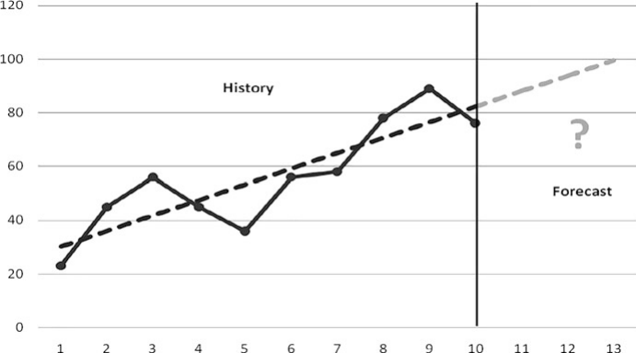
Fig. 12.3 Forecasting, extrapolation and ... statistics
In essence, in statistics we try to find the model that best fits the data. And since
we expect history to repeat itself, we project it and we are happy. Thus, the statistical
forecasting recipe is: Find the best fit → Get the job done → Sleep tight!
However, in time-series forecasting, history very rarely repeats itself!

Slide 15


2 Methods and Quantitative Approaches of Forecasting
2.1 Data and Statistics
Quantitative techniques mainly rely on data, statistical models, and estimation
techniques for forecasting and are the basic elements of forecasting process as
an aid to business decision-making, corporate planning, and management. Data
can be in several forms: spoken and unspoken expression, alphanumeric written
language, and other forms of communications and may consists of numbers, texts,
signs, and images. These data can be time series, cross section, or combination
of the two, that is, panel data. More often, in business and industry, real-time
geographically distributed data on sales, orders, stocks, returns, failures, scheduling,
logistics, budget, and information on competitors are very important and used
in forecasting. Detecting abnormalities and irregularities, identifying outliers and
missing observations, and cleaning and editing datasets for internal consistency are
important aspects and one of the basic steps of setting up a quantitative forecasting
model. One may in addition need to take into account known variations, such as
holidays, calendar days correction (e.g., for leap year), special events, and changes
in inflation rate.

Slide 16
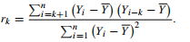
Seasonal and Cyclical Adjustment: Seasonal fluctuations and changes can occur
and repeat more or less regularly and periodically within a year and behavior of the
data show predictability. The drivers of seasonal demands and supply are climate or
festivals which repeat every year during a particular month. The most widely used
tool to test and determine seasonality in time series is plotting the autocorrelation
function (ACF).
Analysis of the autocorrelation coefficient or autocovariance function (ACF)
which shows the relationship between current and lagged values of a time series
is a way to decompose the data and investigate repeating patterns and presence of
a periodic signal obscured by noise. The autocorrelation coefficient can be used
to detect the presence of stationary, seasonality, trend, and random variability in
the data. Specific aspects of autocorrelation processes such as unit root, trend sta_x0002_tionary, autoregressive, and moving averages can be computed. The autocorrelation
coefficient (rk) is computed as:

Slide 17
where k = time lag, n is the number of observations, and Y = observed value. Close to zero values of rk indicate no autocorrelation—the series is not related to each other at any lag k and the variability in the values is random with zero mean and constant variance (Fig. 12.4a). If there is a trend the rk value is high initially then drops off to zero (Fig. 12.4b). In the case there is a seasonal pattern in the data series, rk reappears in cycles, for example, of 4 or 12 lags depending on quarterly or yearly series (Fig. 12.4c).
The autocorrelation between two observations at prior time steps, that is,
correlations between observations at predetermined or specified time lags, in a
data series consists of direct correlations among themselves, as well as indirect
correlations with observation at intervening time steps, that is, correlations with
observations in between specified time lag. The ACF comprises both direct and
indirect correlations among observations and does not control for correlations
of a particular observation with observations at other than the specified lag. An
alternative to ACF is the partial autocorrelation function (PACF) in which indirect
correlations with values at shorter lags are excluded and only direct correlations
with its own lagged values are taken. (Under the assumption of stationarity, the jth
PACF value is obtained by regressing the present values against the past j values
and taking the coefficient of the jth value as the estimate of the PACF coefficient.)
The ACF and the PACF both play important roles in identifying the extent of lags in
autoregressive model such as the ARIMA model discussed in a subsequent section.

Slide 18
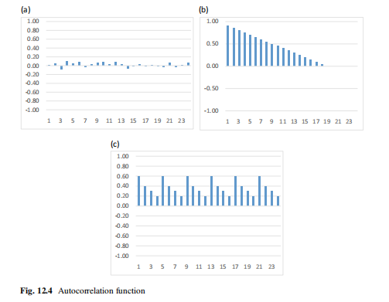

Slide 19

2.2 Time-Series Methods
A time-series data may consist of seasonal fluctuations, a trend, cyclical change, and
irregular components. A simple divide and conquer approach could be to remove
the seasonal and trend components by directly providing estimates of those using
any number of simple techniques and using the smoothing techniques to forecast.
After obtaining such a forecast, the trend and seasonal components can be added
back. Below, we describe smoothing methods (different from the divide and conquer
approach) for handling all three types of series, those without trend and seasonality,
those without seasonality, and those with all the three.
2.2.1 NAÏVE Method (NF)
A naïve method assumes no seasonality and no trend-cycle in the data and simply
sets the latest available actual observation to be the point forecast for periods in
the future. Sometimes seasonally adjusted data is used and the forecasts are re seasonalized.
The naïve model is a kind of a random walk model. The NF is considered a simple benchmark
against which the more advanced results may be compared. In some ways this is reasonable:
the naïve method measures the volatility inherent in the data and in many systems nothing works
better than what happened yesterday.

Slide 20
2.2.2 Average and Moving Average (MA) Methods
A simple average is obviously easy to compute but misses trends and recent changes
in the series. Moving averages are a simple way of smoothing out the seasonality
and noise in a series to reveal the underlying signal of trend used for forecasting. In
the simplest version, the forecast for the future periods is set equal to the average
of the observations of the past k periods. One may wish to optimize on the value of
k. Variants of the simple moving average are weighted and exponentially weighted
moving averages. In weighted moving average, different weights are assigned to
various point observations within a seasonal period to be used for averaging, while
in exponentially weighting, higher weight is assigned for the latest point observation
of a season and lesser weights are assigned in a continuously decreasing manner to
the earlier point observations.
One will notice that there will be no forecast for the first k periods unless fewer
periods are used to produce the initial forecast. Also, the prediction after the last
period of data will be same for every period thereafter.

Slide 21
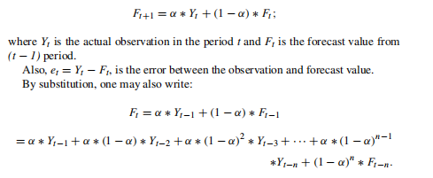
2.2.3 Simple Exponential Smoothing (SES)
In this method one assumes the absence of trend and seasonality in the data.
Brown (1956) is credited with the development of the single exponential smoothing
methodology.
The following formula is used to forecast using the SES method:

Slide 22
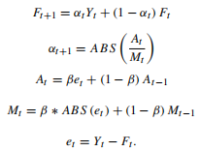
The best α can be found using an optimization approach or simply by trial and error. The forecast can be started in many ways. A popular method is to use the first actual value as the first forecast (Y1 = F1) or set the average of the first few values
as the value of the first forecast.
In sheet “SES” of spreadsheet “FA-Excel Template.xlsx” we have provided
sample data (which can be changed) and the value of the smoothing constant, α, that can be changed. As α changes from zero to 1, the forecast will be seen to follow the most recent value more closely. In the Appendix in the section “SES Method” we
provide the R command for SES. The data is shown in Table 12.6 and the output in
Table 12.10.
In the adaptive-response-rate single exponential smoothing (ARRSES) α can be
modified as changes occur:

Slide 23
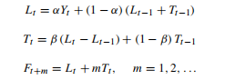
2.2.4 Holt Exponential Smoothing (HES)
Brown’s SES methodology (1956) was extended by Holt (1957) who added a
parameter for smoothing the short-term trend. The current value is called the level
of the series or Lt
. The change in levels (L1 − L1 − 1) is used to determine the trend
during the period t. Then, the trend is smoothed using the previously forecast value,
that is, T1 = (1 − β)T1−1 + β*(L1 – L1−1). This method is also called Double
Exponential Smoothing (DES). The formulae are:
In order to start the forecast, one may set L1 = Y1 and the slope can be obtained by regressing initial values of the series against time. Search methods can be used to select the “optimal” values of the two smoothing constants, α and β. (The word optimal is in quotes because the criterion for optimization could be minimizing
different types of errors, including errors one step or two steps ahead.) An example is shown in sheet “Holt” of spreadsheet “FA-Excel Template.xlsx”. Appendix 1 section “Holt method” lists the R command. The data is shown in Table 12.6 and the output in Table 12.10.

Slide 24
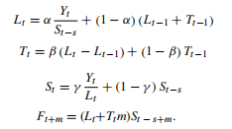
2.2.5 Holt–Winters’ trend and seasonality method
Holt–Winters’ method is a smoothing method that takes both trend and seasonality into account known as Error, Trend, and Seasonality (ETS) or triple exponential smoothing as three components (viz., level, trend, and seasonality) in the data are used and smoothened to arrive at forecast values. It is a variant of Holt method of exponential smoothing in which a component of seasonality index along with trend and level is also added to arrive at forecast:

Slide 25
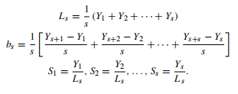
where S1 denotes the seasonal component, s is the length of a season, and γ is the seasonal smoothing factor. Note that after each step we need to renormalize the seasonal factors to add up to k (“Periods in Season”). The initial values for Ls, bs and Ss can be initially calculated as:

Slide 26
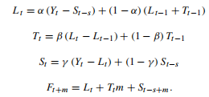
The initial values for level and trend can be chosen like in the multiplicative
method. The seasonality values can be estimated as below to start the forecast:
The data is shown in Table 12.6 and the forecast output (produced by R) is shown
in Table 12.10 for both methods. The R command is listed in the Appendix in the
section “Holt–Winters Method.”

Slide 27
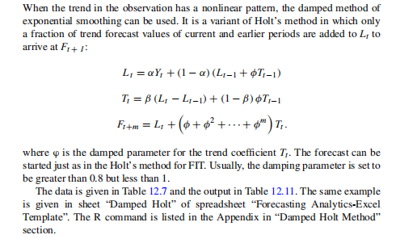
2.2.6 Damped Exponential Smoothing for Holt’s Method

Slide 28
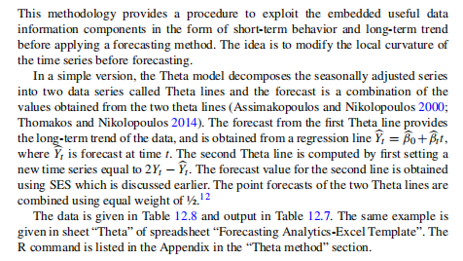
2.2.7 The Theta model

Slide 29
2.2.8 Advances in Time-Series Processes
The Autoregressive Integrated Moving Average (ARIMA) Framework:
Extrapolation models are most frequently and widely used in forecasting with a large dataset, and among them, the exponential smoothing forecast approaches have been the most popular method (Petropoulos et al. 2014). The other advances in quantitative forecasting approaches and class of models are based on the ARMA
framework (Box and Jenkins 1970), Bayesian method of forecasting (Harrison and Stevens 1976), state space models (Chatfield 2005), and application of neural networks (Andrawis et al. 2011; Tseng et al. 2002).

Slide 30
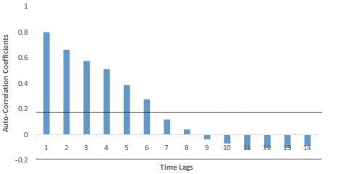
Fig. 12.5 Autocorrelation function
Box and Jenkins developed the ARMA model in 1970. The autoregressive part
(or AR) of the ARMA model can be written as yt = c + ϕ1yt − 1 + ϕ2yt − 2 + ···
+ ϕpyt − p + et , where et is white noise and p lagged values are used. This is a
multiple regression with lagged values of yt as predictors. The lagged explanatory
variable becomes stochastic and contemporaneously correlated with the error
term, making the forecast stochastic and creating bias leading to loss of con-
fidence that comes with estimator bias and variance

Slide 31
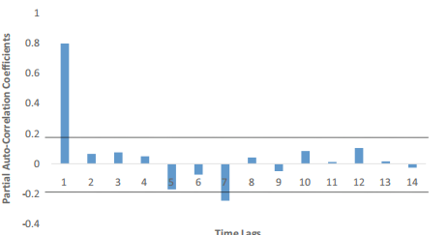
Fig. 12.6 Partial autocorrelation function
The ARIMA model: ARIMA forecasting is used when the condition of no_x0002_autocorrelation and homoscedasticity are violated. Then, it requires transformation
of the data series to stabilize both variance as well as mean. A data series
is said to be stationary when the mean and variance are constant over time.
ARIMA was developed to handle nonstationary data by differencing d-times. Later,
Engle (1982) introduced autoregressive conditional heteroscedastic (ARCH) models
which “describe the dynamic changes in conditional variance as a deterministic
function of past values.” When “additional dependencies are permitted on lags of the conditional variance the model” is called generalized ARCH (GARCH) model
and share many properties of ARMA

Slide 32
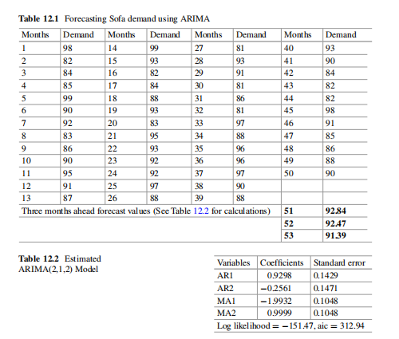

Slide 33
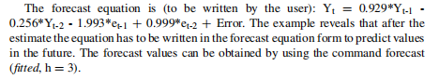
The R command is given in the Appendix in “ARIMA method” section. The
data and summary output of R on an example is given in Table 12.1. The complete output is in Table 12.13. The same data can be found in sheet “Data - ARIMA” in csv format.
EXAMPLE: The monthly demand of sofa (in thousands) by a company for the last
50 months is given below in Table 12.1. The problem is to provide the forecast of
sofa demand for the company for the next 3 months using the ARIMA model.
Solution:
Assume that we want to fit the ARIMA model (2, 1, 2). Assume that the data is
named as ARCV. The R command is: fitted ← arima(ARCV, order = c(2, 1, 2)).
Here, fitted is where the output will be placed.
The ARIMA parameters of order p = 2, d = 1, q = 2 are estimated using MLE
(maximum likelihood estimation) methods and automated nonlinear numerical
optimization techniques. The coefficients are obtained by calling fitted.

Slide 34
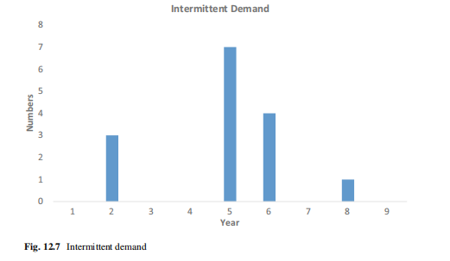

Slide 35
2.2.8 Advances in Time-Series Processes
The Autoregressive Integrated Moving Average (ARIMA) Framework:
Extrapolation models are most frequently and widely used in forecasting with a large dataset, and among them, the exponential smoothing forecast approaches have been the most popular method (Petropoulos et al. 2014). The other advances in quantitative forecasting approaches and class of models are based on the ARMA
framework (Box and Jenkins 1970), Bayesian method of forecasting (Harrison and Stevens 1976), state space models (Chatfield 2005), and application of neural networks (Andrawis et al. 2011; Tseng et al. 2002).

Slide 36
2.3 Forecasting Intermittent Demand
The SES method assumes a constant probability for the occurrence of nonzero
values which is often violated leading to count data or intermittent series (Lindsey
and Pavur 2008). It is found that around 60% of the stock-keeping units in industrial
settings can be characterized as intermittent (Johnston et al. 2003). Intermittent
demand is characterized by infrequent demand arrivals and variable demand sizes
when demand occurs. As Fig. 12.7 shows, there are “periods with demand followed
by periods of no demand at all, and on top of this even the demand volume (when
realized) comes with significant variation. There are two things to forecast: when the
next demand period is going to be realized? And, whenever demand is realized, what
will be the volume of this demand?” The basic technique is to combine different
time block and different methods have been proposed to doing so. The SES method
performs poorly in cases of stochastic intermittent demand.
Croston (1972) developed methodology for forecasting such cases and suggested
decomposition of intermittent series into nonzero observations and the time intervals
between successive nonzero values. The two series, namely, quantity and the
intervals, are extrapolated separately. An updating is done for both quantity and
interval series only after a nonzero value occurs in quantity series.

Slide 37
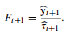
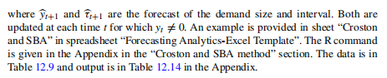
2.3.1 Croston’s Approach (CR)
This approach applies SES independently to demand size y and inter-demand
interval τ independently, where τ = 1 for non-intermittent demand:

Slide 38
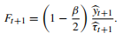
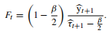
2.3.2 Syntetos and Boylan Approximation (SBA)
Syntetos and Boylan (2001) found that Croston’s methodology provides upward
biased forecast. Subsequently, they proposed an improved Croston’s methodology
in which the final forecasts are multiplied by a debiasing factor derived from the
value of the smoothing parameter of intervals (Syntetos and Boylan 2005). Syntetos
and Boylan (2005) found that Croston method is biased on stochastic intermittent
demand and corrected the bias by modifying the forecasts to:
SBA works well for intermittent demand but is biased for non-intermittent
demand. Syntetos and Boylan (2001) avoided this problem by using a forecast:
This removes the bias but it increases the variance of the forecast. Other variants
include that of Leven and Segerstedt (2004).
None of these variants handle obsolescence well. When obsolescence occurs
these methods continue to forecast a fixed nonzero demand forever. An example
of SBA is provided in sheet “Croston and SBA” in spreadsheet “Forecasting
Analytics – Excel Template”. The R command is given in the Appendix in the
“Croston and SBA Method” section.

Slide 39
2.4 Bootstrapping Method
Often, the forecasting task is to predict demand over a fixed leadtime. In this case
bootstrapping might be used. Bootstrapping (Efron 1979) is a statistical method
of inference that uses draws from sample to create an approximate distribution.
Willemain et al. (2004) produce accurate forecasts of the demand of nine companies
over a fixed lead time compared to exponential smoothing or Croston’s method. We
illustrate with an example.
EXAMPLE: Demand for an Automobile Part
Suppose, we would like to forecast the automobile part demand for the next
3 months. Historically, the 24 monthly demand for the part is given as follows
(Table 12.3).
Solution:
Bootstrap scenarios of possible total demands for 3-month lead periods are created
by taking random sample with replacement as follows:
1. Months: 3,17,21; demand: 7 + 0 + 0 = 7.
2. Months: 1,20,8; demand: 0 + 13 + 0 = 13.
3. Months: 6,14,19; demand: 2 + 9 + 5 = 16.
Continuing this process, we can build the demand distribution for the given lead
time.

Slide 40
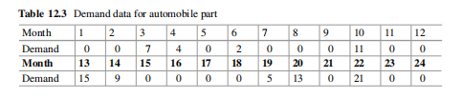
3 AFA—Applied Forecasting Analytics Process
Forecasting in business is performed at an operational, tactical, and strategic level:
• At the operational level—where the focus of this chapter is, we are mostly
interested in being “roughly right within the limited available time,” given in
order to prepare the forecasts. This involves short-term forecasting tasks; real_x0002_life applications are usually a few weeks/months ahead. For some category of
products (e.g., dairy) we may even need more frequent forecasts (every day or
every other day).
• Tactical forecasting involves short- to mid-term forecasting, usually 3–12 months
ahead. Cumulative and individual point forecasts are needed for this period, as
well as, we would incorporate the effect of forthcoming events like promotions
and supply interruptions.

Slide 41
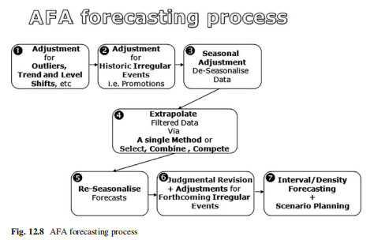
• At the strategic level we usually look into forecasting horizons that go beyond a
year and involve the impact of rare events (like major international crises as the
recent one regarding energy prices and the global credit system), new product
development, product withdrawals, capacity amendments, and scenario planning.

Slide 42
The aforementioned forecasting horizons are only indicative, and often met in
supply chain forecasting. There are many forecasting applications where a strategic
forecast is just for a few months ahead! So, in order to avoid any confusion, we
use the terms: “forecast for x steps ahead” or “forecast for x periods ahead”, without
specifying what steps/periods stand for. These steps could be anything from minutes
to years depending on the application area. Typically short-term forecasting involves
1–3 steps ahead; medium-term or mid-term is for 4–12 steps ahead; and long-term
anything over 12 steps ahead
This chapter proposes a simple seven-step forecasting process tailored for oper_x0002_ational forecasting tasks. This process is illustrated in Fig. 12.8, and is abbreviated
as “AFA forecasting process” or just AFA for short.
AFA provides detailed guidance on how to prepare operational forecasts for a
single product. This process should be:
(a) Repeated for every product in your inventory, and
(b) Rerun each time new demand/sales data becomes available.
Thus, if we observe our inventory of 100 products on a monthly basis, we should
run AFA every month for each of the hundred products we manage.

Slide 43
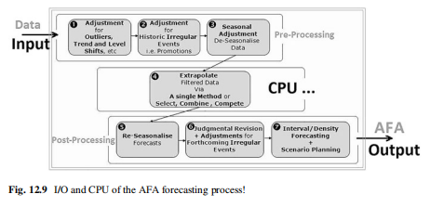
Let us start decoding what these boxes stand for; there is one box for each of the
seven steps of the AFA process. The upper three form the preprocessing phase, the
one in the middle the main-forecasting-task, and the latter three the post-processing
phase.
It looks like a typical Black-Box approach.14 However, we believe it is more like
a “Grey-Box” approach! A situation where you will be able to understand most of
the things that are happening throughout AFA, however rely on automated tools to
deliver for you!

Slide 44
Let us explore the AFA process as illustrated in Fig. 12.8:
• First Box: the BAD things...
Each single time series comes with a number of problems. Some of these
are dead-obvious but some are well hidden. To cut the long story short, we
must deal with all these “bad things” and prepare a series with no missing
values, no extremely low/high values (outliers), no level or trend shifts; this
would involve automated detection algorithms for such problems and suggested
solutions in order to adjust the original series into new series, filtered for all the
aforementioned problems.
• Second Box: the GOOD things...
In time-series forecasting it is often very difficult to tell good things from bad
ones ... just like in real life! A ‘good thing’ in a time series is a special event
(SE), often termed in literature as irregular, infrequent or rare event; it could be a
promotion, a production interruption, news, regulation, etc., in general anything
that could make demand deviate substantially from regular levels! But why is
something irregular good? Simply because it is an information-rich period, a
period with special interest where an external/exogenous event has driven excess
or limited demand respectively. So it would look exactly like an outlier, but we
will know what exactly happened. From a mathematics perspective, the way you detect
and subsequently adjust periods with special events, is identical to the one
used to treat outliers.

Slide 45
• Third Box: the REGULAR things...
In forecasting, finding regularities and patterns in a series is an essential task;
usually termed periodicity, things that repeat themselves on a regular basis. If the
regularity, the repetition happens within a year then we will call this phenomenon
seasonality; for less than a year mini-cycles, while for more than a year, big
economic/financial-cycles.
• THE (fourth) BOX: FORECASTING ...
This is where all the fun is ... . Let us try forecasting: extrapolate the series
in the future. We will not just choose a method—and that is it! (where would the
fun be after all ... ?).
We basically employ three fundamental strategies ... the “three forecasting
tricks” as I fancy calling them:
– “Select”: my mother always says that “Experience is all that matters ... ”;
and she is probably right. Thus if a method worked well in the past, we
should probably stick to it, and keep on selecting that same one for the task
of extrapolation. Furthermore, some methods may have been proven to work
better for some products while other methods better for other products; so
there are “horses for courses” and once again we are better off sticking to
them. In essence, we could build a nice table—a selection protocol (SP) as we
will call it more formally, where in one column there is a list of our products,
while in the other column the forecasting methods and models that have
worked well in the past for the respective products.

Slide 46
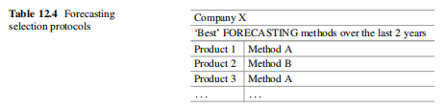
– “Combine”:
When in doubt ... combine!
a very good piece of advice I dare say. When a method has worked well in the
past for a certain product, but the new Statistician on the block ... insists that
method X is the new panacea in time-series forecasting, then why not combine
those two? So get a set of forecasts from your trusty chosen method, get another
set of forecasts from the new highly promising method, and then average these to get
a final set of forecasts.
– “Compete,” the true reason forecasters exist: (empirical) Forecasting Competi_x0002_tions! We do not trust anything, and from all the available methods and models,
applied on all the available history, we will find the one that forecasts “best.”
These criteria typically include average or median error metrics like MAE,
MdAE, MAPE, MDAPE, MASE, and MdASE.

Slide 47
• Fifth Box: Superimpose regular patterns.
By now, our forecasts should look like a straight line, either flat or with a
certain slope. If we have identified regularities in step three, then we need to bring
them back into the game, in other words we superimpose these patterns onto the
extrapolation. Once this step completed, our forecasts will have ups and downs,
and will look like a natural extension of the cycles and seasonality observed in
the history of the series.
• Sixth Box: Human Judgment.
This is where humans come into the game. No matter how sophisticated the
process so far, people—usually referred to as forecasters or experts—want to
intervene at this stage; primarily to introduce market intelligence? This is usually
performed in two phases: (a) an initial phase, where experts roughly revise all
provided forecasts by changing18 them by a percentage x% (e.g., increase all
monthly forecasts for the full next year by 10%), and (b) a more targeted one,
where some specific forecasts in the future are adjusted for the potential impact
of special events like promotions (e.g., increase by an extra 1000 units the sales
forecast for next September due to an expected advertising campaign).
• Seventh (Last) Box: Density forecasting + SCENARIOS; living with Uncer_x0002_tainty!

Slide 48
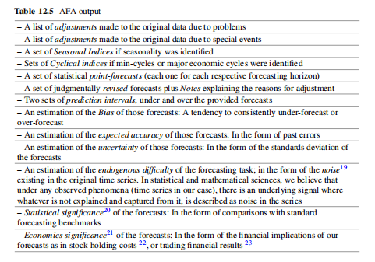

Slide 49
• In this final step, we try to cope with the uncertainty that comes with the produced
forecasts. Firstly, we usually provide a set of confidence or prediction intervals,
associated with the point forecasts for the full forecasting horizon, as shown in
Fig. 12.2; this is also known as density forecasting. There are theoretical as well
empirical ways so as to produce these intervals. The most popular way to deal
with the uncertainty around the provided forecast is by building scenarios. These
practically derivate from the produced forecasts, but we will treat them as an
indispensable part of the AFA process.
We have seen the input; we have roughly seen the steps within the “grey-box”; let
us stay a bit more on the output of AFA. When you started reading this chapter, you
probably thought it would all be about a number or a few numbers—if forecasts for
more periods ahead were required. By now, it should have become obvious that far
more output—in numerical and narrative form—will be available. Practically every
step of the AFA process is producing some output, which is consisted by-and-large
of what is contained in Table 12.5. AFA Output (which is not exhaustive).

Slide 50
4 A Few More Interesting FORECASTING Applications
So what are we really fascinated to forecast?
Whenever I say outside my inner academic circle that I am a forecaster or into
forecasting/predictive analytics, I typically get three responses:
What’s going to be the weather tomorrow?
Can you forecast the numbers for the lottery?
Can you forecast the stock market?
My answer to all these is: ... “Unfortunately NO”. And this brings us back
to the fundamental question: “what can realistically be forecasted, and what can
not?” Maybe more interestingly the latter is what people are really interested in
forecasting ...
The aforementioned questions are clearly beyond the scope of this chapter ...
particularly the weather! The following list is not exhaustive, but we believe captures
most of the things people are interested to forecast:
– Gambling / Individual and team performance in sports.
– Weather forecasting.
– Transportation forecasting.
– Economic forecasting/Major Economic shocks.
– Technology forecasting.
– Earthquake prediction/Major catastrophes.
– Land use/Real estate forecasting.
– Long term/Strategic forecasting/Foresight.

Slide 51
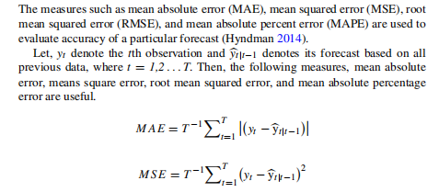

5 Evaluating Forecast Accuracy

Slide 52
Some practical considerations: It is not appropriate to compare these error
measures across models that do and do not incorporate trend and seasonality. The
reason is that even those accommodations can be somewhat ad hoc. Moreover, the
errors could be correlated, and therefore adding them across periods might create a
wrong notion of overall accuracy. ACF diagnoses of the errors might reveal patterns
that can help identify seasonality and trends as mentioned in several places in the
chapter. In addition, out of sample testing is also recommended.
The error estimates are for the forecast for the current period. However, they can
also be computed two steps or three steps ahead. This is done by comparing the
actual versus the forecast obtained for that period, but two or three periods ago.
Often, prediction intervals are necessary to the user. For example, one might like
to know how the uncertainty in the forecast values changes for different forecast
horizons. The inventory planner would like to use the prediction interval to source
sufficient number of parts to ensure s/he does not run out of stock more than 10% of
the time. A farmer might like to know what extent price can deviate if the produce is
harvested and sold next week instead of right now. As one may anticipate, making
these types of predictions involves making assumptions about the structure of error
distribution. Forecasting packages often produce 1.25 times the MAD as an estimate
of standard deviation. One may also compute a heuristic interval by using past data,
generate a forecast, and determine the interval by trial and error.

Slide 53
6 Conclusion
This chapter aims to provide managers/executives as well as managers-to-be
(PG/MBA students), with the necessary background knowledge and software tools
to run a successful business forecasting analytics function. Ok ... but there at
least 50 titles out there in business forecasting! ... Why do we need another one
recapturing the analytics end of? This chapter is not about all the things you could
possibly do when you are faced with a forecasting task.
Electronic Supplementary Material
All the datasets, code, and other material referred in this section are available in
www.allaboutanalytics.net.
• Data 12.1: Data - ARIMA.csv
• Data 12.2: Data - Croston and SBA.csv
• Data 12.3: Data - Damped Holt.csv
• Data 12.4: Data - SES, ARRSES, Holt, HoltWinter.csv
• Data 12.5: Data - Theta.csv
• Data 12.6: FA - Excel Template.xlsx
• Code 12.1: Forecasting Analytics.R
• Data 12.7: Forecasting chapter - Consolidated Output.xlsx

Slide 54
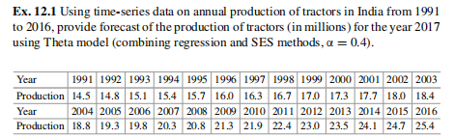
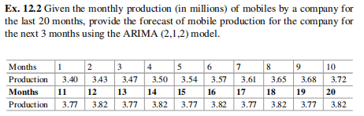
Exercises

Slide 55
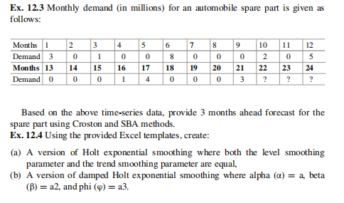

Slide 56
Appendix 1
Example: The monthly sales (in million USD) of Vodka is given for the period
1968–1970. We want to forecast the sales for the year 2016 using various forecasting
methods—SES, ARRSES, Holt, Holt–Winters (Additive/Multiplicative).
Data: The data can be downloaded from the book’s website and the dataset name
is “Data - SES, ARRSES, Holt, HoltWinter.csv”. You can also refer to Table 12.6 for
data.
R Code (to read data)
read.csv (“filename.ext”, header = TRUE)
SES Method
Install forecast package
install.packages(“forecast”)
R function
ses (<Univariate vector of observations>, h = <number of periods
to forecast)
Note: The ses function in R by default optimizes both the value of alpha and the
initial value.
In case you prefer the output for a specified alpha value then use parameter
<initial = ”simple”>
and set the alpha value in the parameters.
ses(<univariate vector of observations>, h = <number of periods
to forecast>, alpha = < >, initial = “simple”)

Slide 57
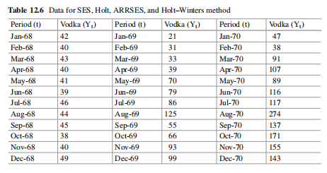
The above code will set the first forecast value equal to first observation. If alpha
is omitted it will optimize for alpha.

Slide 58
Holt Method
Install forecast package
install.packages(“forecast”)
R function.
holt (<univariate vector of observations>, h = <number of
periods to forecast>)
Note: The holt function by default optimizes both the value of alpha and the
initial value.
In case you prefer the output for a specified alpha and beta value then use
<initial = ”simple”>
parameter and set the alpha and beta values in the parameters.
holt (<univariate vector of observations>, h = <number of
periods to forecast>, alpha = < >, beta = < >, initial =
“simple”)
The above code sets first level equal to first value and trend as difference of first
two values. If alpha is omitted it will optimize for alpha.
Holt–Winters Method
Install stats package
install.packages(“stats”)

Slide 59
R function
HoltWinters (<name of dataset>, alpha = <>, beta = <>, gamma =
<>, seasonal = c(”additive”, “multiplicative”), start.periods =
2, l.start = NULL, b.start = NULL, s.start = NULL, optim.start
= c(alpha = 0.3, beta = 0.1, gamma = 0.1),
optim.control = list())
The value of alpha, beta, and gamma can be either initialized by specifying
<alpha>, <beta>, <gamma> and if they are NULL it will optimize the values as
specified in optim.start. You can also specify starting values of alpha, beta, and
gamma to optimize using <optim.start> parameter. Seasonality can be considered
additive or multiplicative. The <start.periods> is the initial data used to start the
forecast (minimum 2 seasons of data). Starting values of level <l.start>, trend
<b.start>, and seasonality <s.start> can be either be initialized or optimized by
setting equal to NULL.
For the HoltWinters function, the dataset must be defined as a time-series (ts)
type. A dataset can be converted to time-series type, using the below code:
ts (<name of dataset>, frequency = number of periods in a season)
Damped Holt Method
Data: The data can be downloaded from the book’s website and the dataset name
is “Data - Damped Holt.csv”. You can also refer to Table 12.7 for data.
Install forecast package
install.packages(“forecast”)

Slide 60
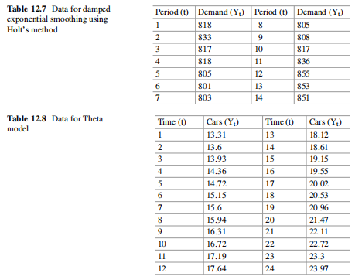
R function
holt (<univariate vector of observations>, h = <number of
periods to forecast>, damped = TRUE)

Slide 61
Note: The holt function by default optimizes both the value of alpha and the
initial value.
In case you prefer the output for a specified alpha, beta, and phi values then
use <initial = ”simple”> parameter and set the alpha, beta, and phi values in the parameters.
holt (<univariate vector of observations>, h = <number of
periods to forecast>, damped = TRUE, alpha = < >, beta = < >,
phi = < >)
If alpha, beta, and phi are omitted, it will optimize for these values.
Theta method
Data: The data can be downloaded from the book’s website and the dataset name
is “Data - Theta.csv”. You can also refer to Table 12.8 for data.
Install forecTheta package
Install.packages(“forectheta”)
R function
stm (ts (<univariate vector of observations>), h = <number of
periods to forecast>, par_ini = c (y[1]/2, 0.5,2))

Slide 62
ARIMA method
Data: The data can be downloaded from the book’s website and the dataset name
is “Data - ARIMA.csv”.
Install forecast package
install.packages(“forecast”)
R function
arima (ts (<univariate vector of observations>, freq = <period
of data>), order = c(<p>,<d>,<q>))
To view the fitted coefficients, store the output and call that array.
To forecast, use the command:
forecast (<name of output>, h = <number of periods to forecast>)
Croston and SBA method
Data: The data can be downloaded from the book’s website and the dataset name
is “Data - Croston and SBA.csv”. You can also refer to Table 12.9 for data.
Install tsintermittent package
install.packages(“tsintermittent”)
R function
crost (ts(<univariate vector of observations>), h = <number of
periods to forecast>, w = c(<>,<>), init = c(<>,<>), type =
“croston”, init.opt = FALSE)

Slide 63
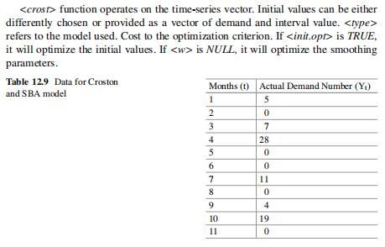

Slide 64
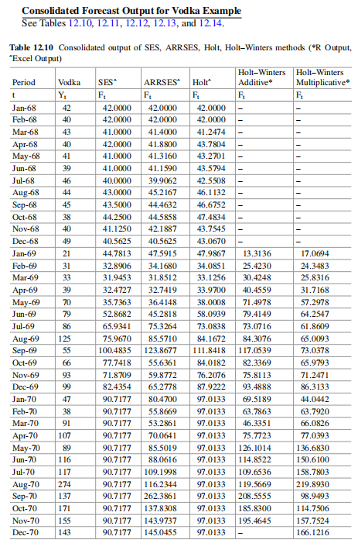

Slide 65
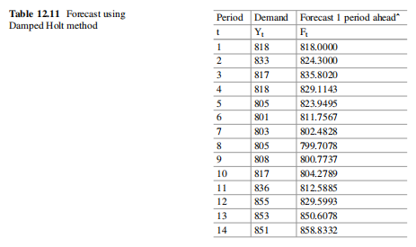

Slide 66
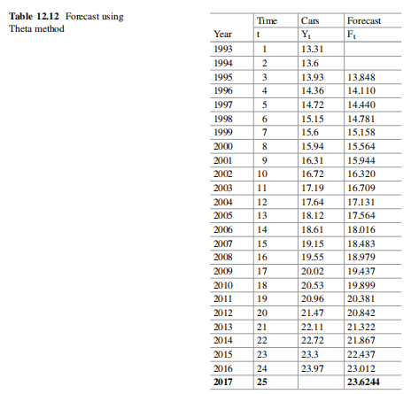

Slide 67
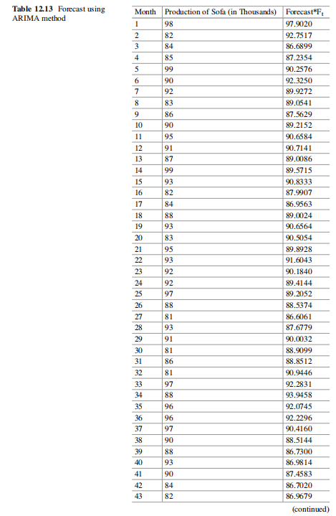

Slide 68
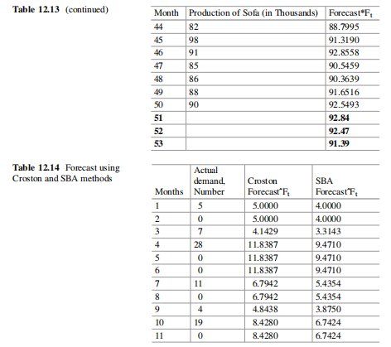

Slide 69
THANK YOU!! :)

